Slide 1
Agricultural Engineering
6.0 Understand basic agricultural engineering
principles and practices

Slide 2
Agricultural Engineering Industry
Agricultural mechanics: the design, operation, maintenance, service, selling and use of power machinery, equipment, structures and utilities in agriculture

Slide 3
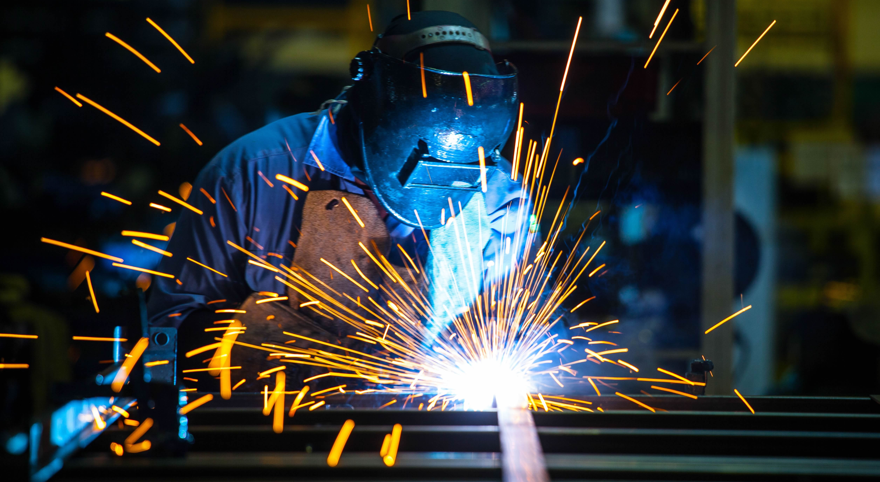
Agricultural Engineering Industry
Many careers include the use of various specialized tools and the development of important skills

Slide 4
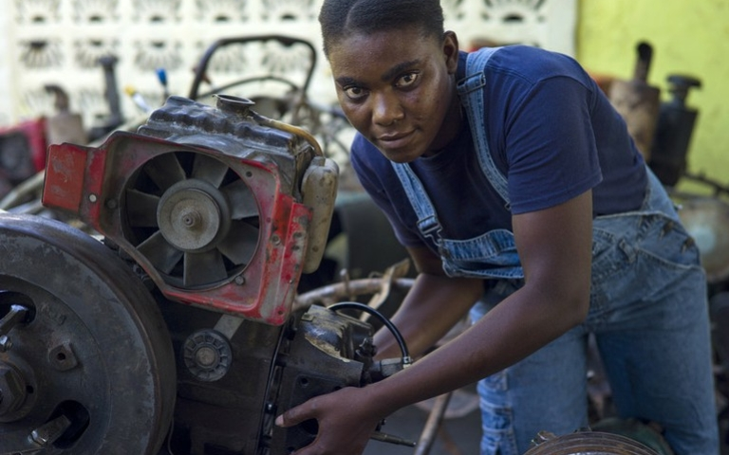
Agricultural Engineering Industry
Attracts students interested in the operation, maintenance, service and selling of agricultural equipment

Slide 5
Agricultural Engineering Industry
Education needed varies with the type of Ag mechanics career chosen

Slide 6
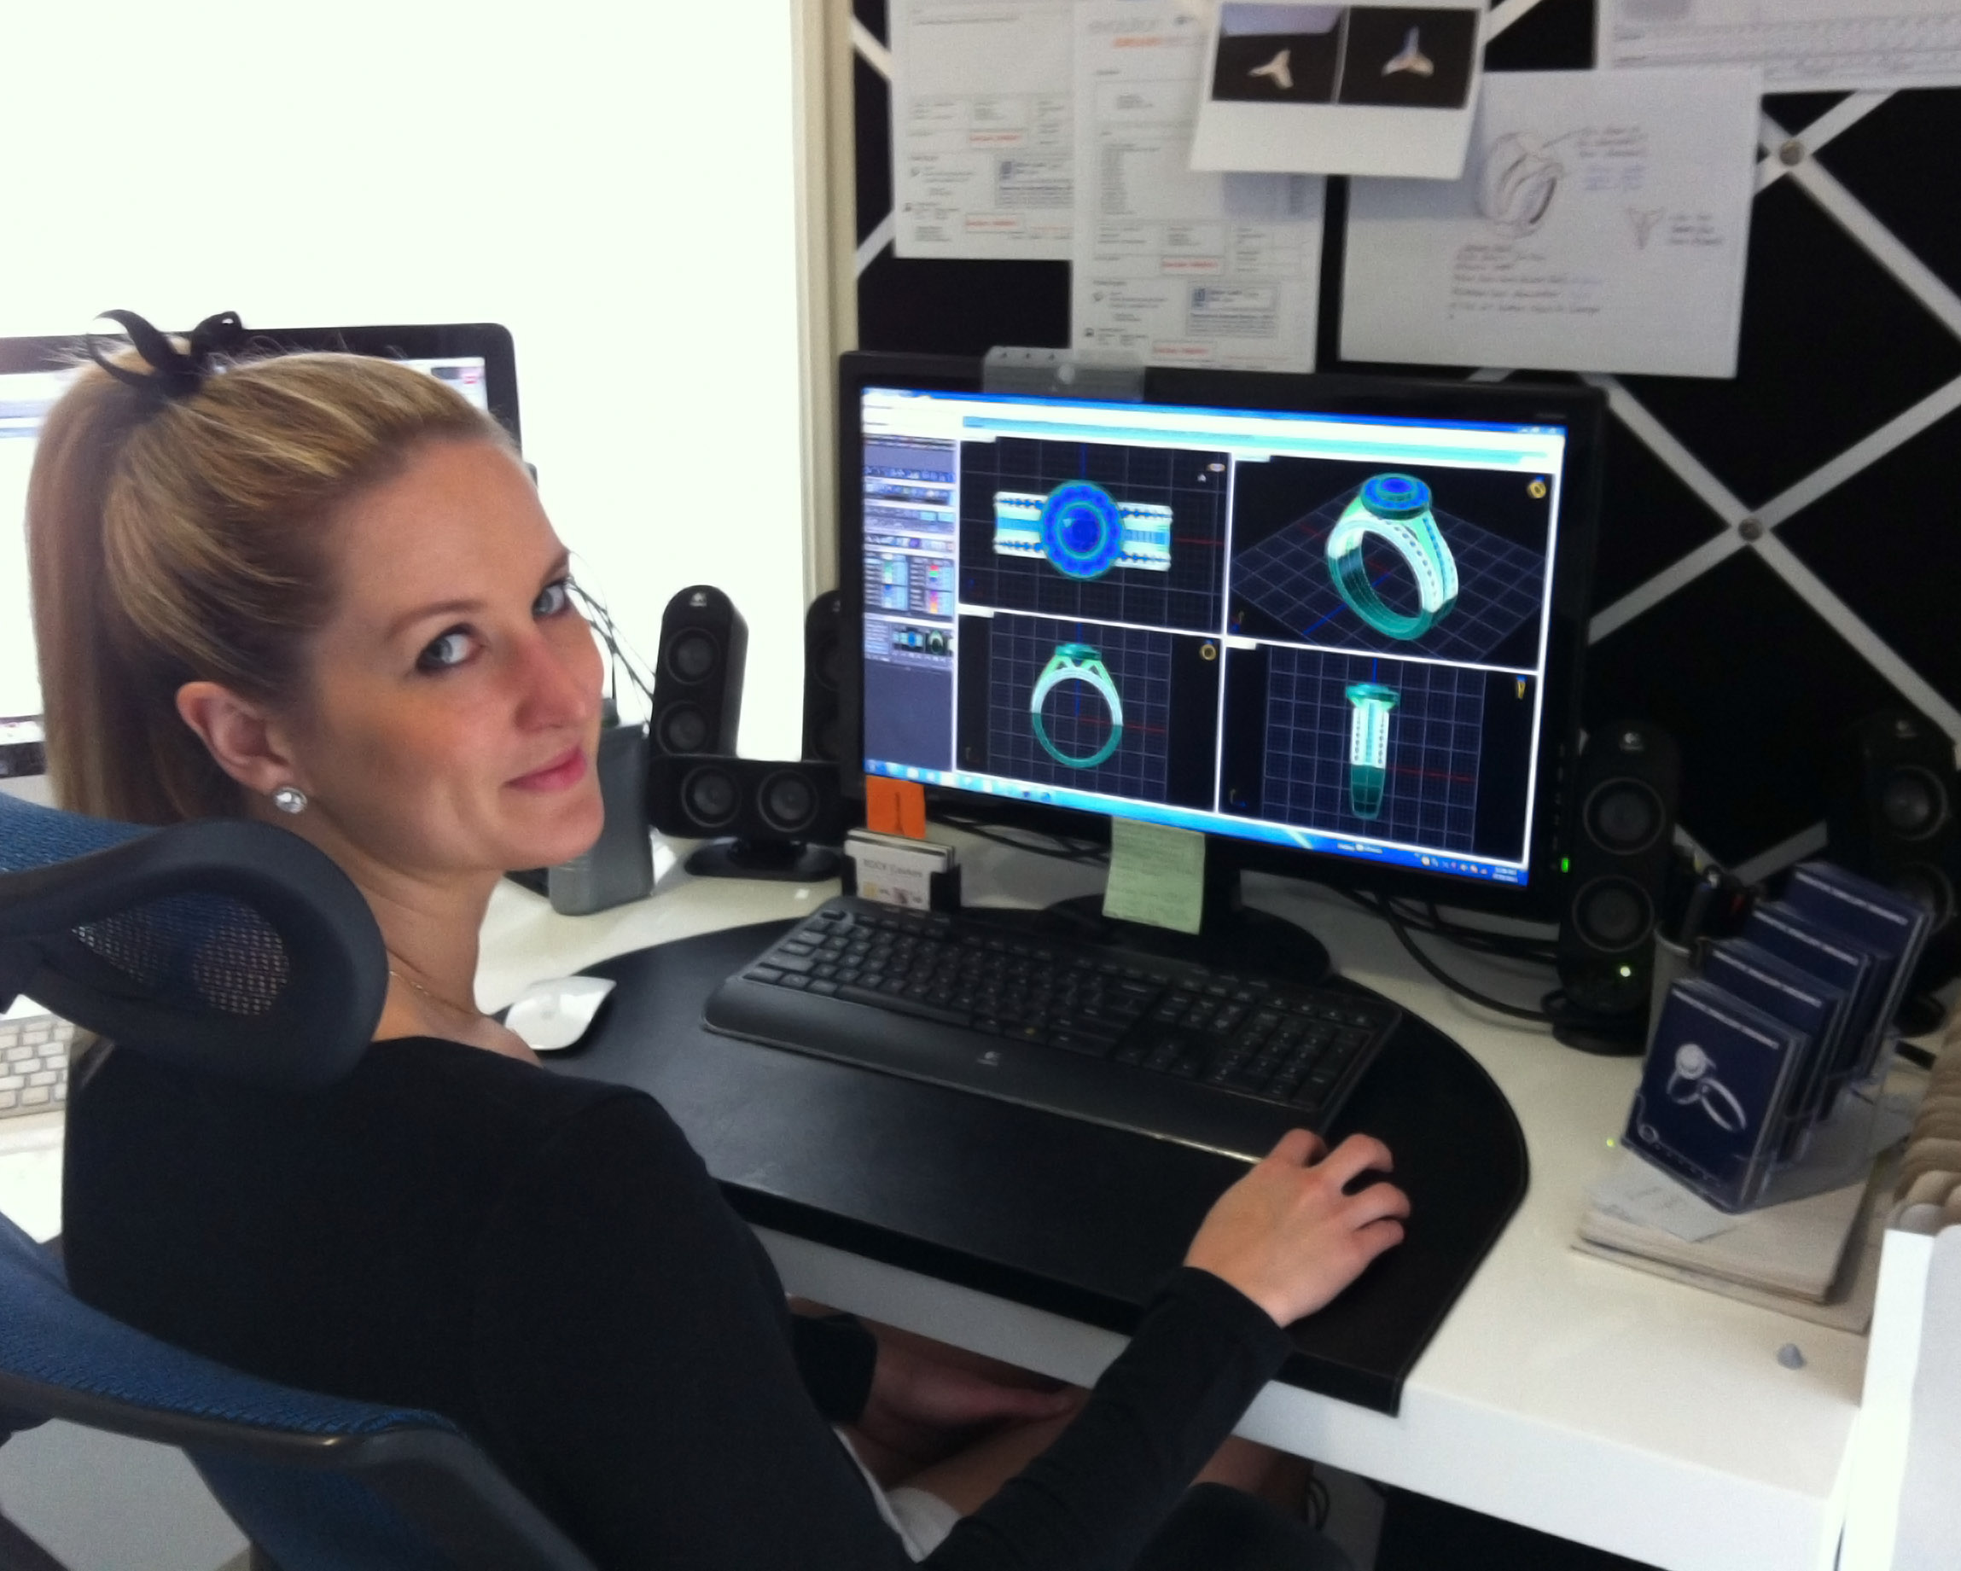
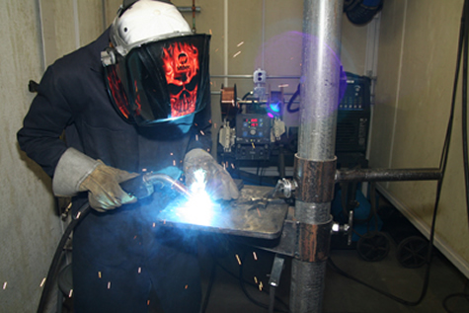
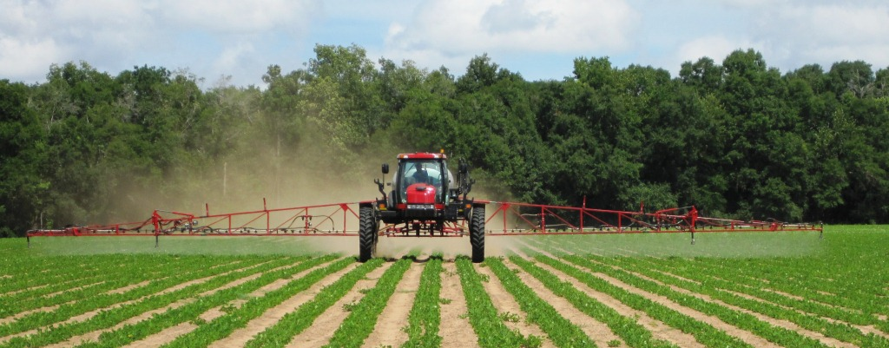
Agriculture Engineering Industry
Working conditions can vary from outside to inside, shop to office or a combination of conditions.

Slide 7
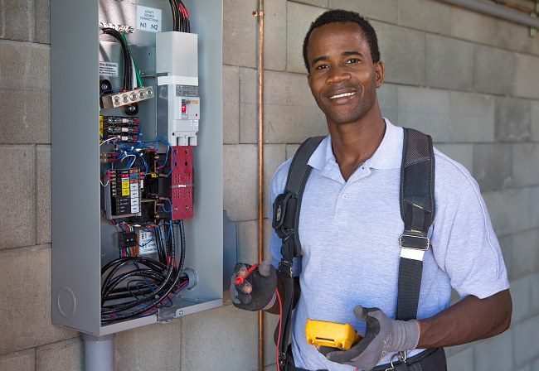
Careers in Agricultural Engineering
Agricultural Electrification, Power and Controls
Electrician
Safety technician
Electrical engineer

Slide 8
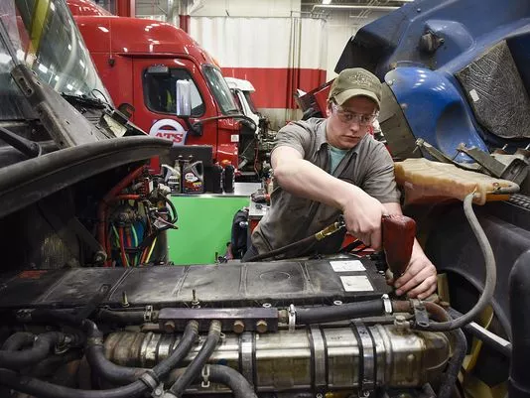
Careers in Agricultural Engineering
Agricultural Power Machinery
Heavy equipment diesel mechanic
Parts person
Equipment sales person
Small engine mechanic
Large machinery operator

Slide 9
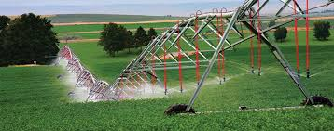
Careers in Agricultural Engineering
Soil and Water Engineering
Soil conservation technician
Irrigation engineer

Slide 10
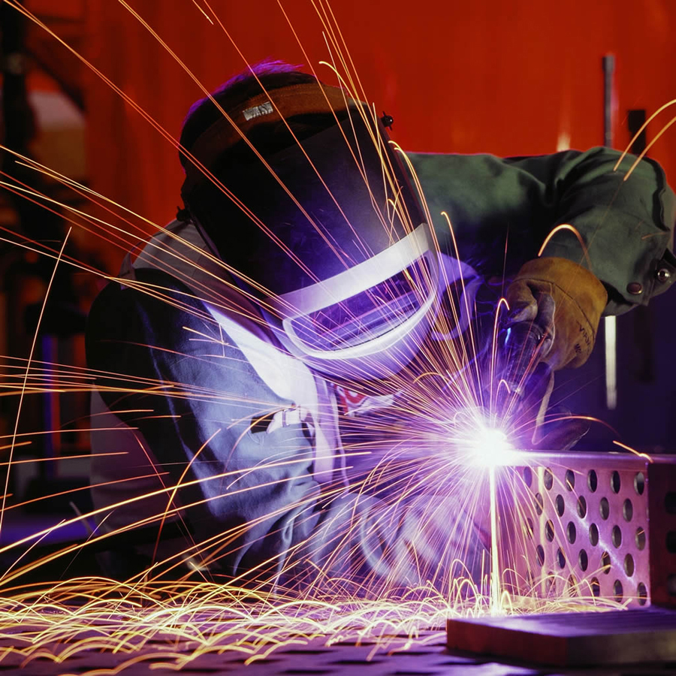
Careers in Agricultural Engineering
Agricultural Mechanics, Construction, and Maintenance Skills
Construction worker
Welder
Safety specialist

Slide 11
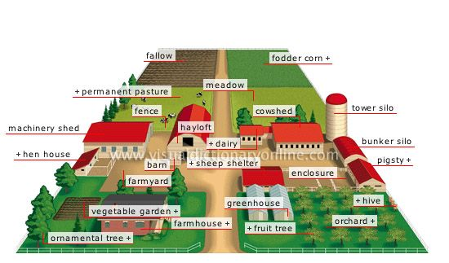
Careers in Agricultural Engineering
Agricultural Structures, Equipment, and Facilities
Construction supervisor
Farmstead planner
Greenhouse builder
CAD engineer

Slide 12
Research an Agricultural Engineering Career
Choose an agricultural engineering career to research and PRESENT your findings to the class.
Create an attractive poster to use as a visual aid.
Use color
Use drawings
Writing must be legible
You will be presenting to the class on Wednesday when I return ☺

Slide 13
Research an Agricultural Engineering Career
Your poster should include but is not limited to:

Slide 14
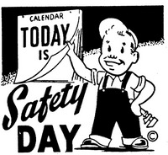
Shop Safety

Slide 15
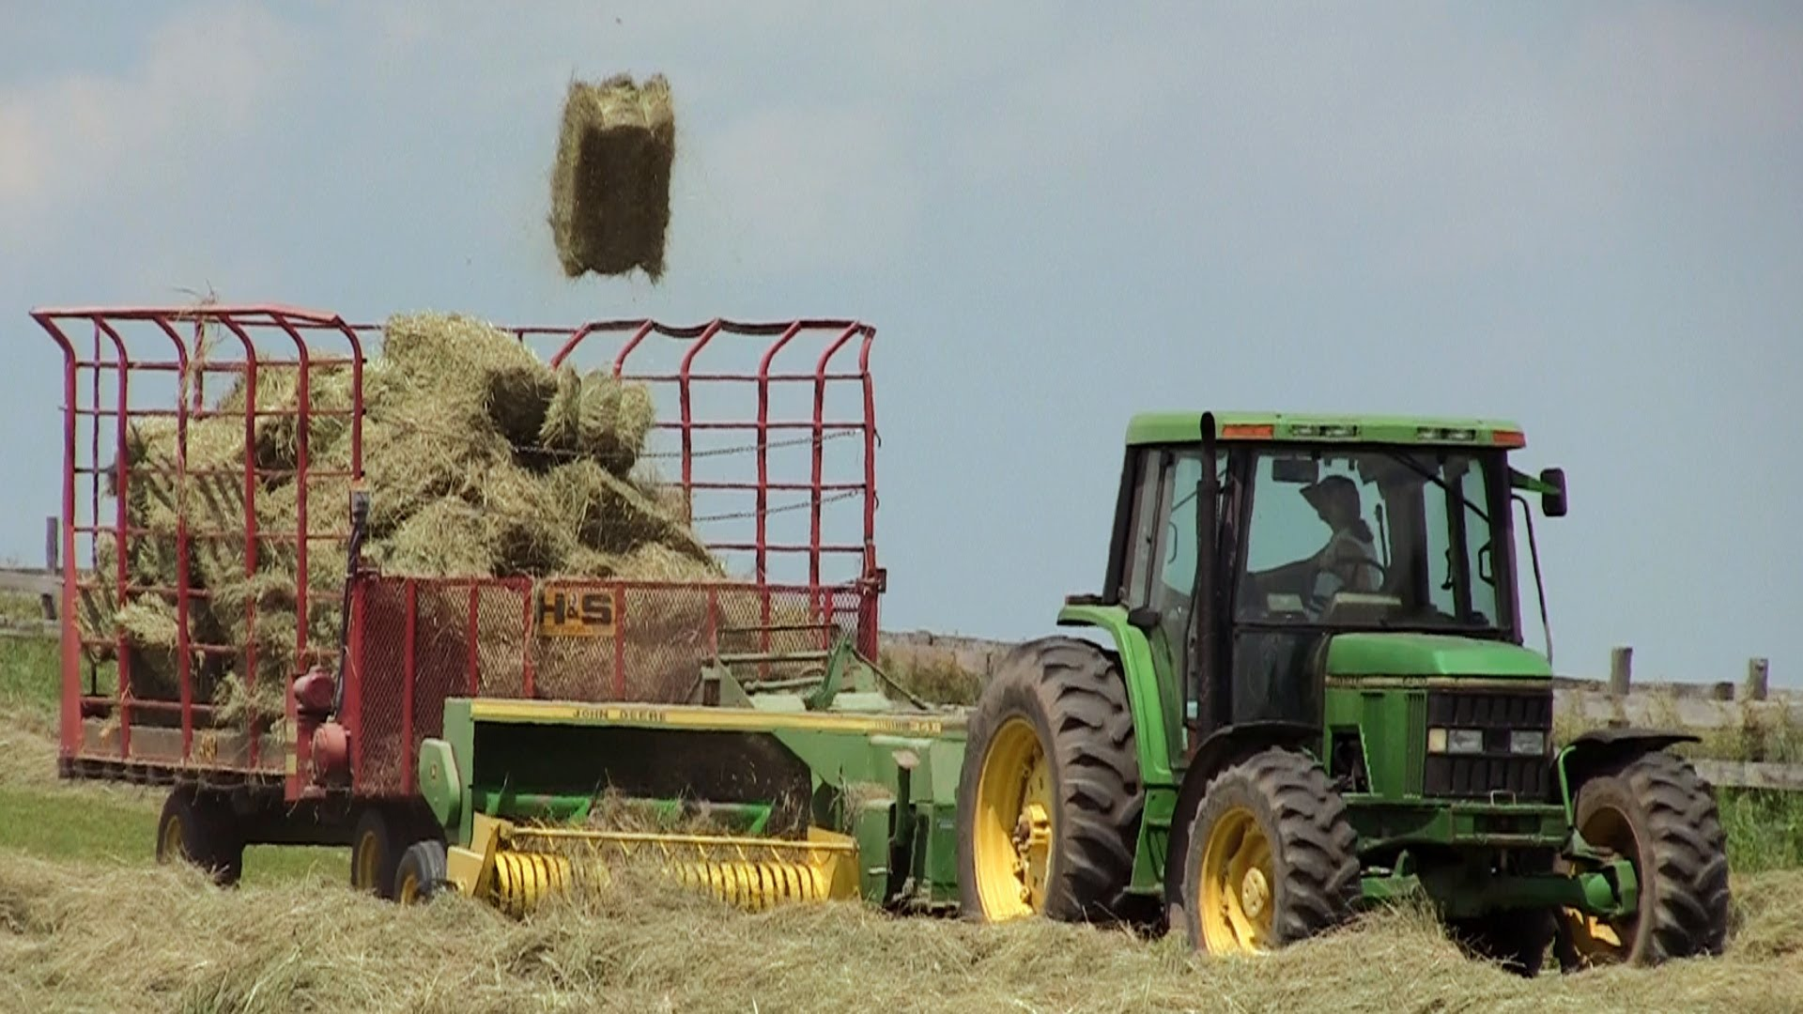
Safety Awareness and Principles for Safety
Of all farm related accidents, 50% involve working with machinery.
https://www.youtube.com/watch?v=p71Lg5c83bc
Safety involves developing an environment free from danger, risk, or injury.

Slide 16
Safety Awareness and Principles for Safety
https://www.youtube.com/watch?v=dBf6BTX1bmM
The #1 key to shop safety is the PEOPLE who use the shop.
Trained properly
Pass a safety test

Slide 17
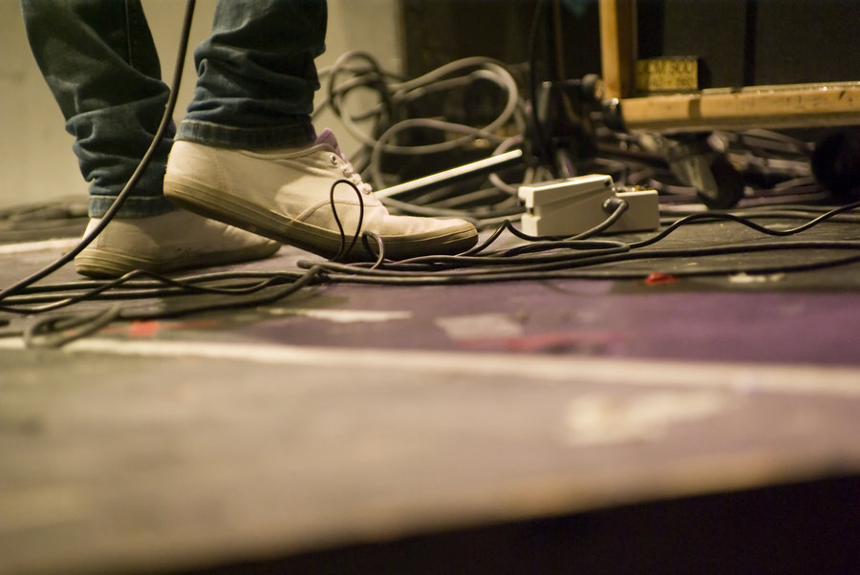
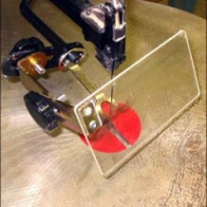
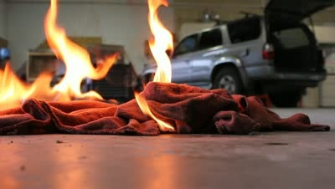
Basic Rules
Keep the shop in a an orderly manner to prevent tripping and related injuries
Remove unnecessary hazards such as oily rags
Minimize danger by making certain all machines have safety shields in place prior to and during operation.

Slide 18
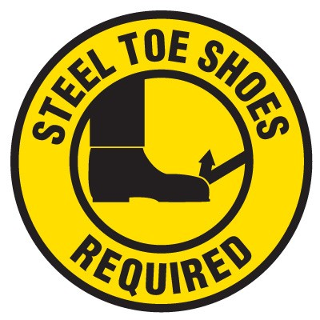
Basic Rules
Wear appropriate personal protective clothing and devices at all times.
Notes:
Safety glasses: prevent eye injury
Steel-toed shoes: protection from dropped or falling items
Ear Protection: can prevent hearling loss when the noise level exceeds 90 DB

Slide 19
Find the safety violation…

Slide 20
Find the safety violation…

Slide 21
Find the safety violation…

Slide 22
Find the safety violation…

Slide 23
Find the safety violation…

Slide 24
Safety Color Coding
National organizations worked together to develop the systems.
American Society of Agricultural Engineers
American Vocational Association
Color coding alerts people to dangers and hazards, provides information to help one react quickly in an emergency.

Slide 25
Safety Color Coding
DANGER
Used on safety switches and fire extinguishers

Slide 26
Safety Color Coding
WARNING
Designates machine hazards, such as edges and openings.
Used as background for electrical switches, levers, and controls.

Slide 27
Safety Color Coding
CAUTION
Identifies wheels, levers, and knobs that adjust or control machines.

Slide 28
Safety Color Coding
INFORMATION
Used on signs such as “Out of Order to identify broken shop equipment that does not work.

Slide 29
Safety Color Coding
SAFETY
Indicates the presence of first aid and safety equipment

Slide 30
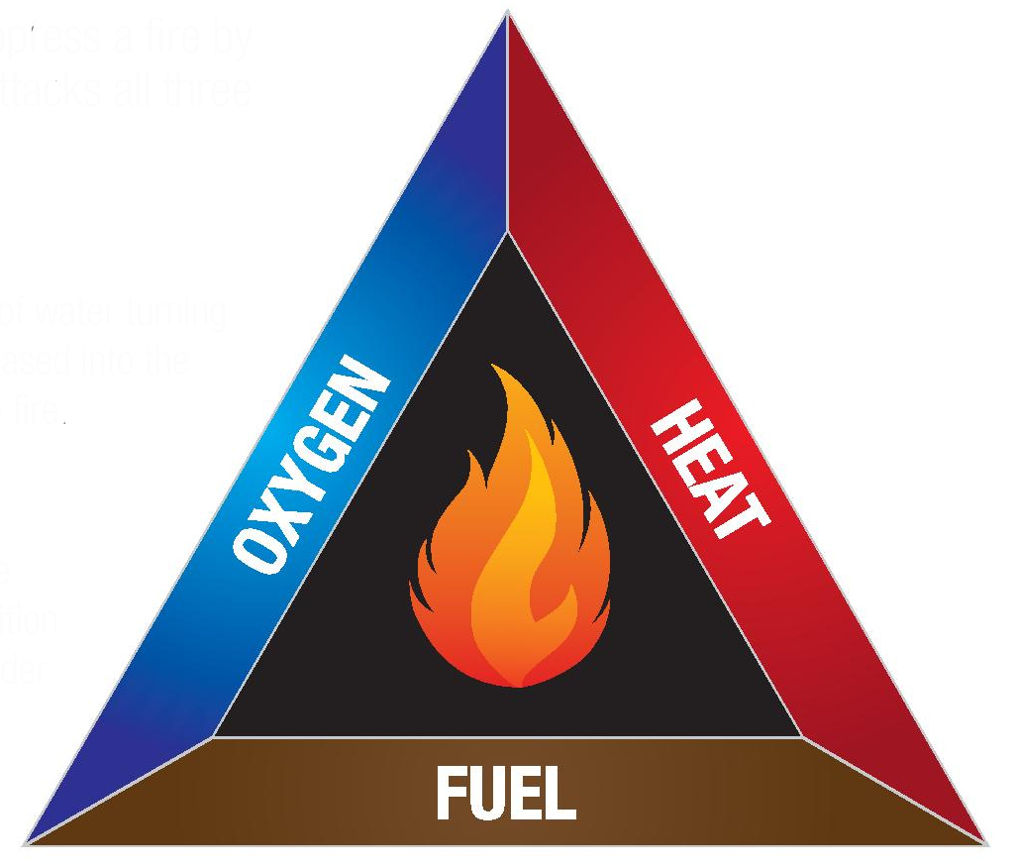
Fire Hazards in the Ag Mechanics Shop
The Fire Triangle
Fuel: any combustible material that will burn. (oily rags, sawdust, paper)
Heat: most material will burn if made hot enough
Oxygen: gas in the atmosphere that is not a fuel, but must be present for fuels to burn.

Slide 31
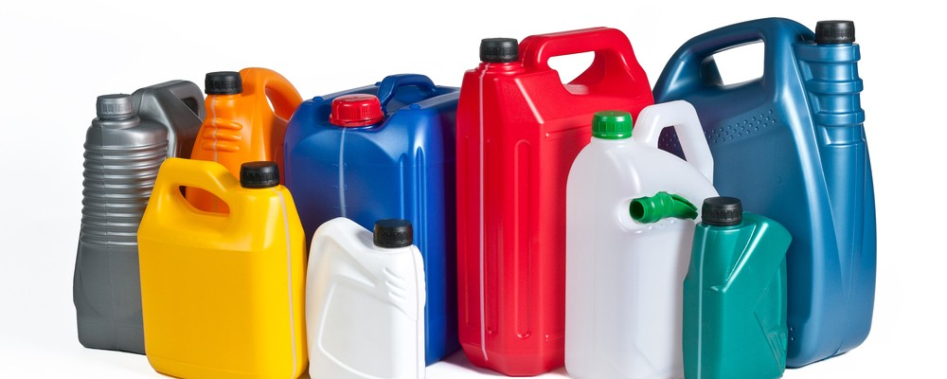
Fire Hazards in the Ag Mechanics Shop Fire Prevention
Take away one of the components of the fire triangle and the fire will not start or will stop.
Safe storage of fuels or combustible materials is the easiest fire prevention strategy
Store fuel in approved containers
Clean shop facilities.

Slide 32
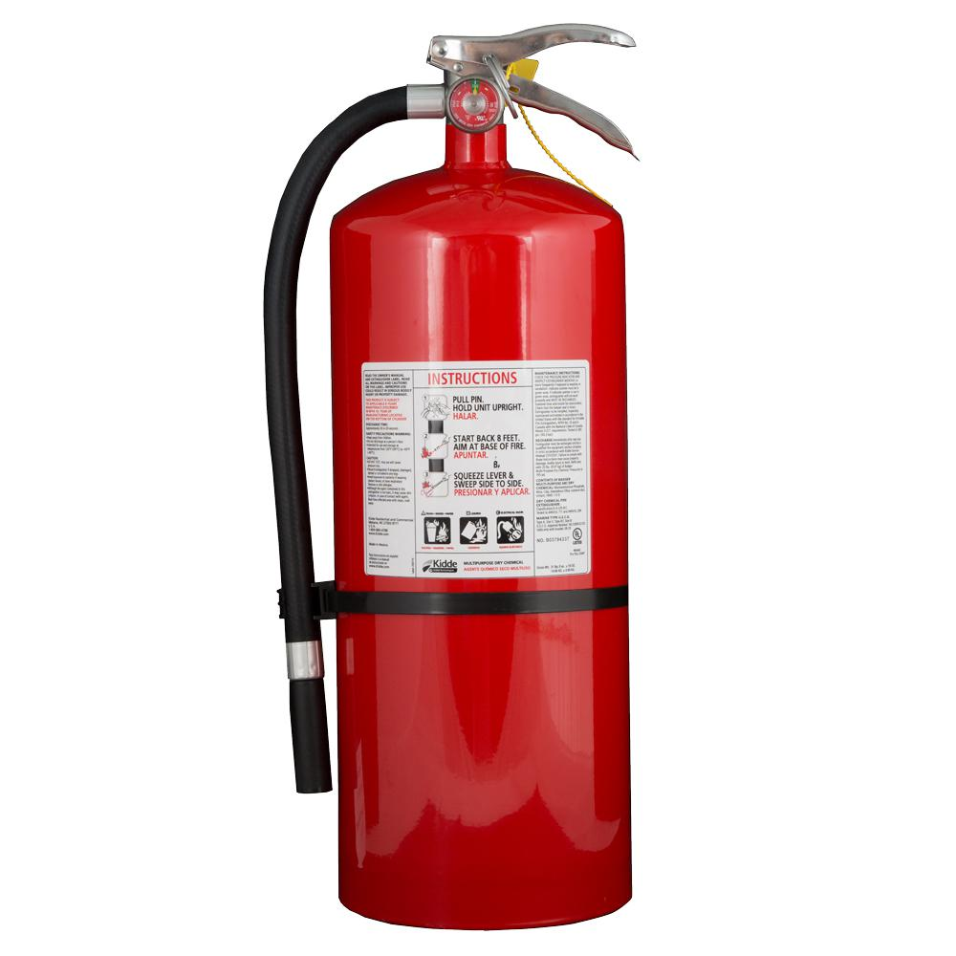
Fire Hazards in the Ag Mechanics Shop Extinguishing Fires
Know the kind of fire extinguisher that is used for different kinds of fires
EX: Class A fire extinguisher use water to control ordinary combustibles
Know the placement of fire extinguisher if a fire takes place
Should be hung on walls within easy reach in areas where fires would most likely occur
Know how to use a fire extinguisher
1. hold upright 2. pull ring-pin 3. lever is pressed
Aim at the base of the fire to extinguish
Fire extinguishers https://www.youtube.com/watch?v=2Z2C13gJh-g

Slide 33
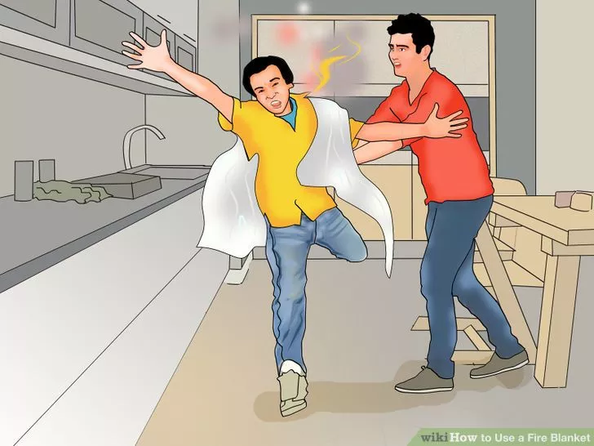
Fire Hazards in the Ag Mechanics Shop Extinguishing Fires
Other examples
Wrapping a person in a blanket whose clothes are on fire
Cooling with water from a hose or bucket.

Slide 35
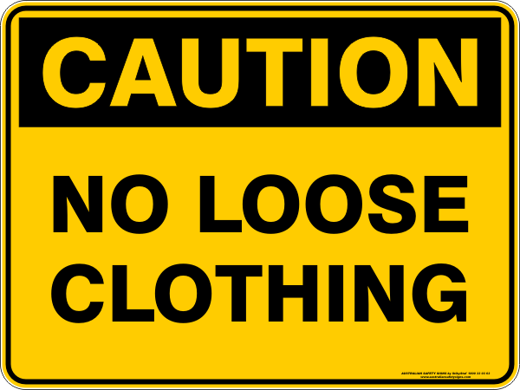

Slide 36
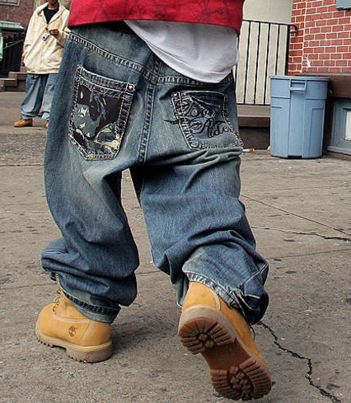

Slide 39
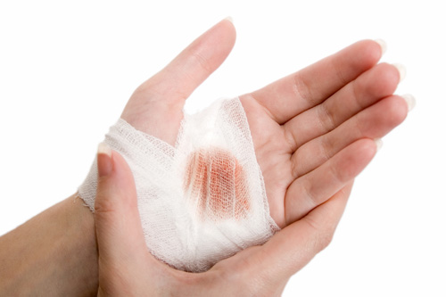
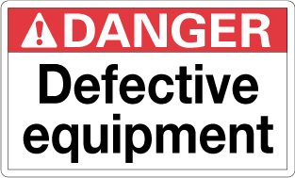
Immediately notify Ms. Brewer of these situations:
Injury

Slide 40
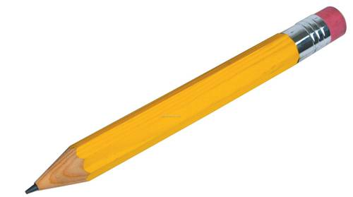
Planning an Ag Engineering Project
Simple Project Designs
The first item needed for the highest quality scaled drawing is:

Slide 41
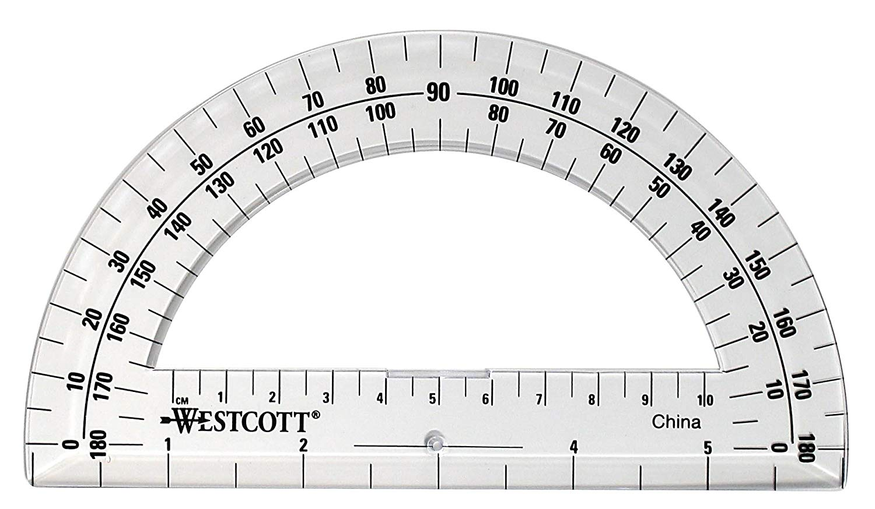
Planning an Ag Engineering Project
Simple Project Designs
A protractor is used for drawing and measuring angles.

Slide 42
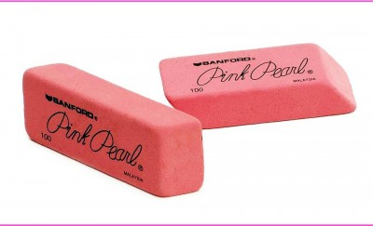
Planning an Ag Engineering Project
Simple Project Designs
A good eraser helps make corrections without distorting the image.

Slide 43
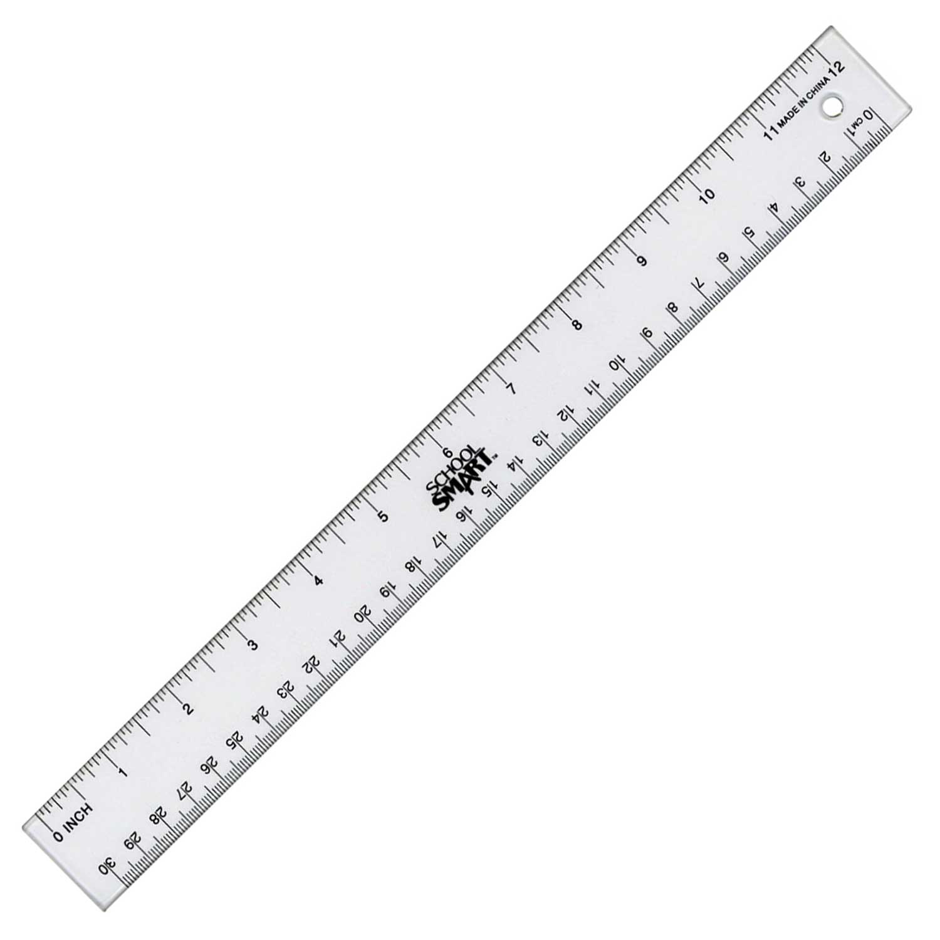
Planning an Ag Engineering Project
Simple Project Designs
A 12 inch ruler will work for basic drawings.

Slide 44
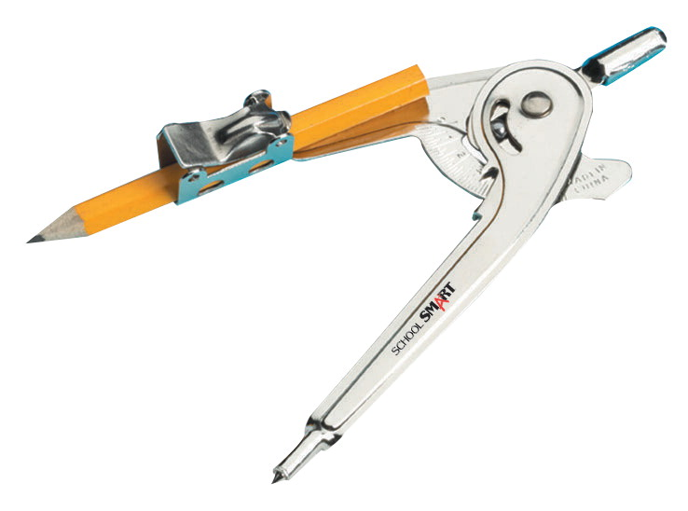
Planning an Ag Engineering Project
Simple Project Designs
A compass is used for drawing circles and arches.

Slide 45
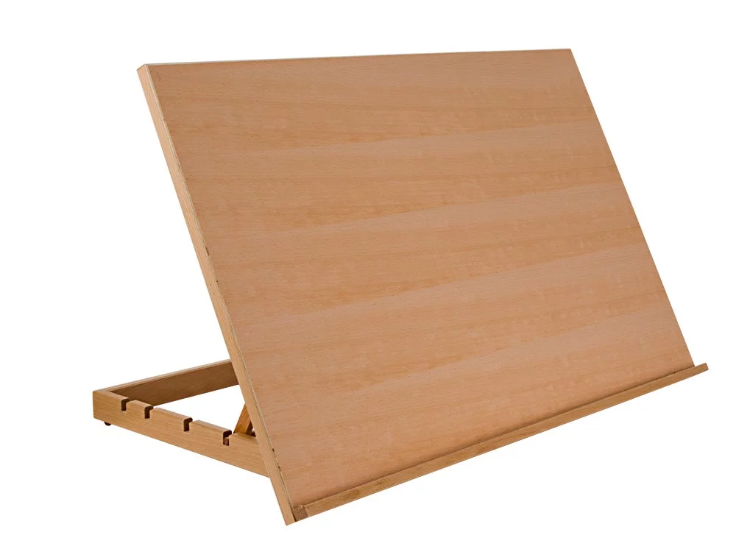
Planning an Ag Engineering Project
More detailed plans
A drawing board is used for attaching the drawing paper.
Use masking tape to secure the drawing to the board.

Slide 46
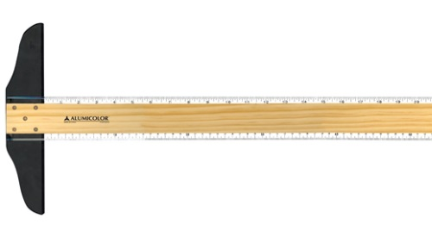
Planning an Ag Engineering Project
More detailed plans
The T-square is helpful for drawing horizontal lines.

Slide 47
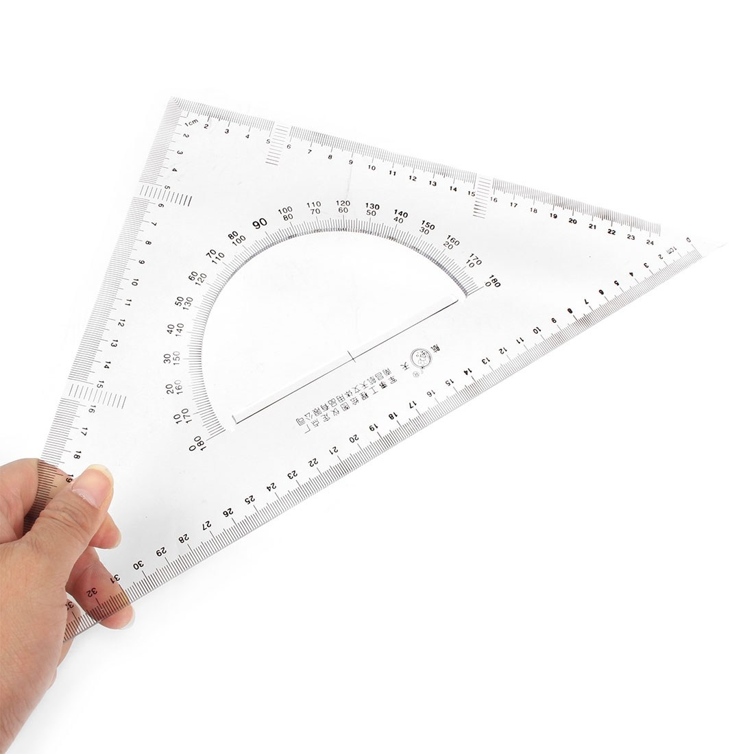
Planning an Ag Engineering Project
More detailed plans
The right triangle in conjunction with the T square, is used to draw vertical lines.

Slide 48
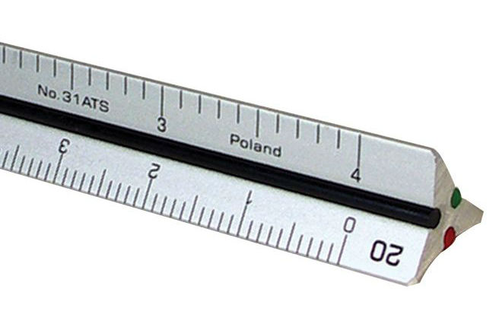
Planning an Ag Engineering Project
More detailed plans
The scale is an instrument with all increments shortened according to proportion.

Slide 49
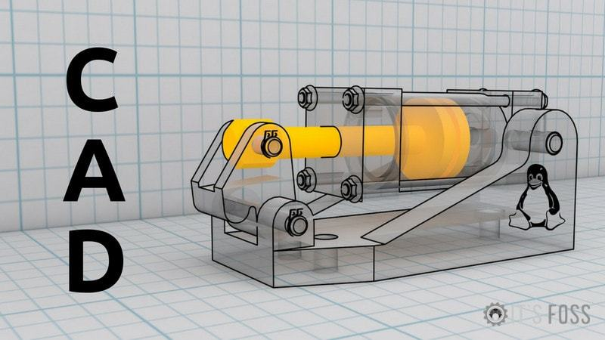
Planning an Ag Engineering Project
Large Scale Projects
Use CAD (computer aided design) for large projects to significantly reduce design time.

Slide 50
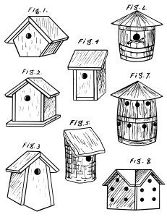
Basics of Drawing
Sketch
Rough drawing that is NOT to scale. A sketch does have dimensions included.

Slide 51
Basics of Drawing
Pictorial Drawing
Shows all three dimensions at once. All three views, front, side, and top are in view.

Slide 52
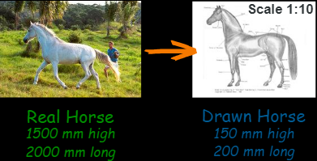
Basics of Drawing
Scale Drawing
A drawing that represents an object in exact proportion although the object is larger or smaller than the drawing itself.

Slide 53
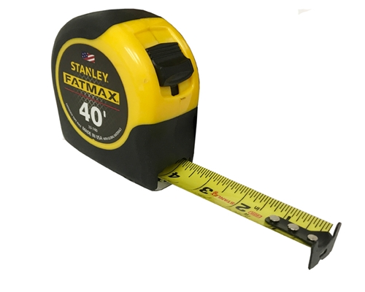
Reading a Tape Rule
Tape Rule
Displays units of measure from the US customary system and the metric system
Marked to show halves, quarters, eighths, and sixteenths

Slide 54
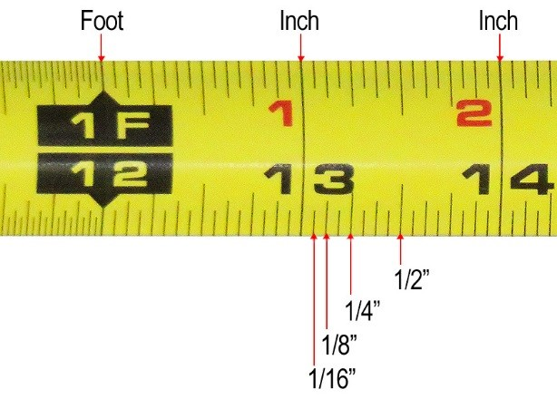
Reading a Tape Rule
Tape Rule
Marked to show halves, quarters, eighths, and sixteenths

Slide 55
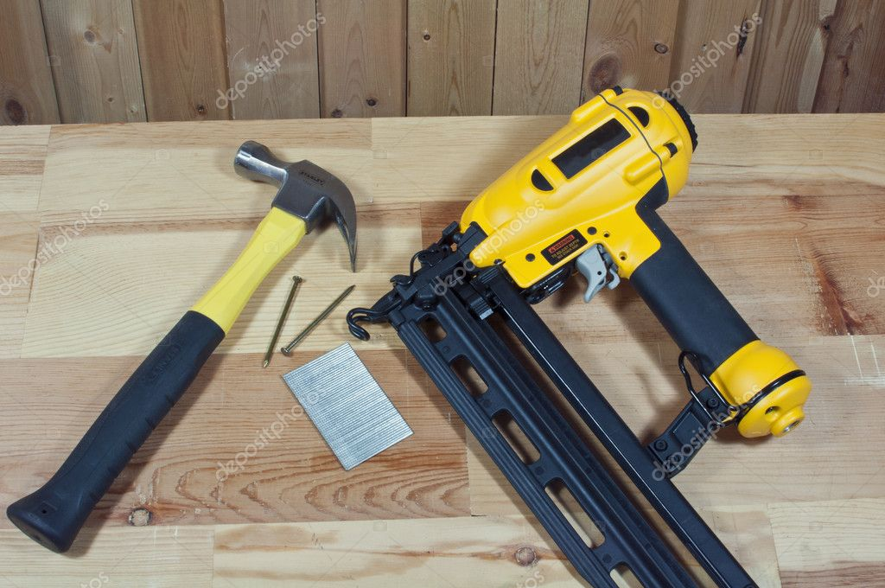
Basic Construction Project Tips
Wood Projects
The fastest way to fasten wood is by nailing.
Use a nail hammer or nail gun.

Slide 56
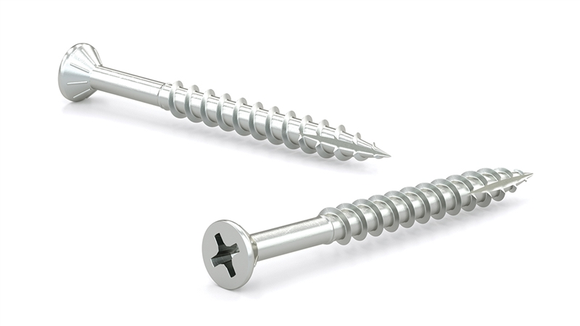
Basic Construction Project Tips
Wood Projects
Screws hold better than nails and are driven quickly with power screw drivers
Flathead screws are most used. The Phillips head is preferred.

Slide 57
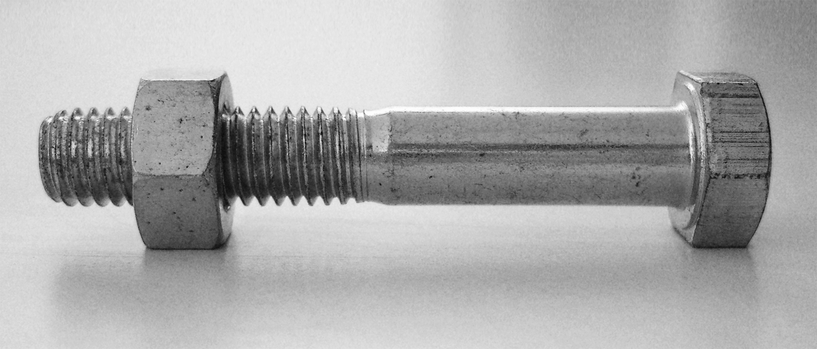
Basic Construction Project Tips
Wood Projects
Bolts are particularly useful for fastening wood at high stress points.
Use these at high stress points like on picnic tables.

Slide 58
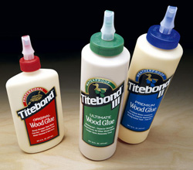
Basic Construction Project Tips
Gluing
A properly glued wood joint will be as strong as the wood itself.

Slide 59
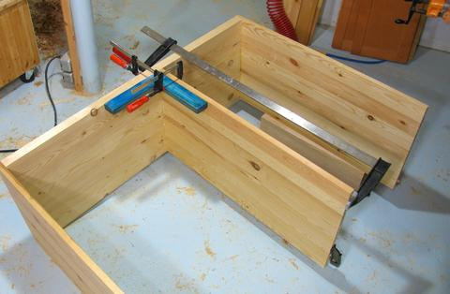
Basic Construction Project Tips
Gluing
Often accompanied by nails, screws, etc.
Boards are held in place for gluing by clamps.

Slide 60
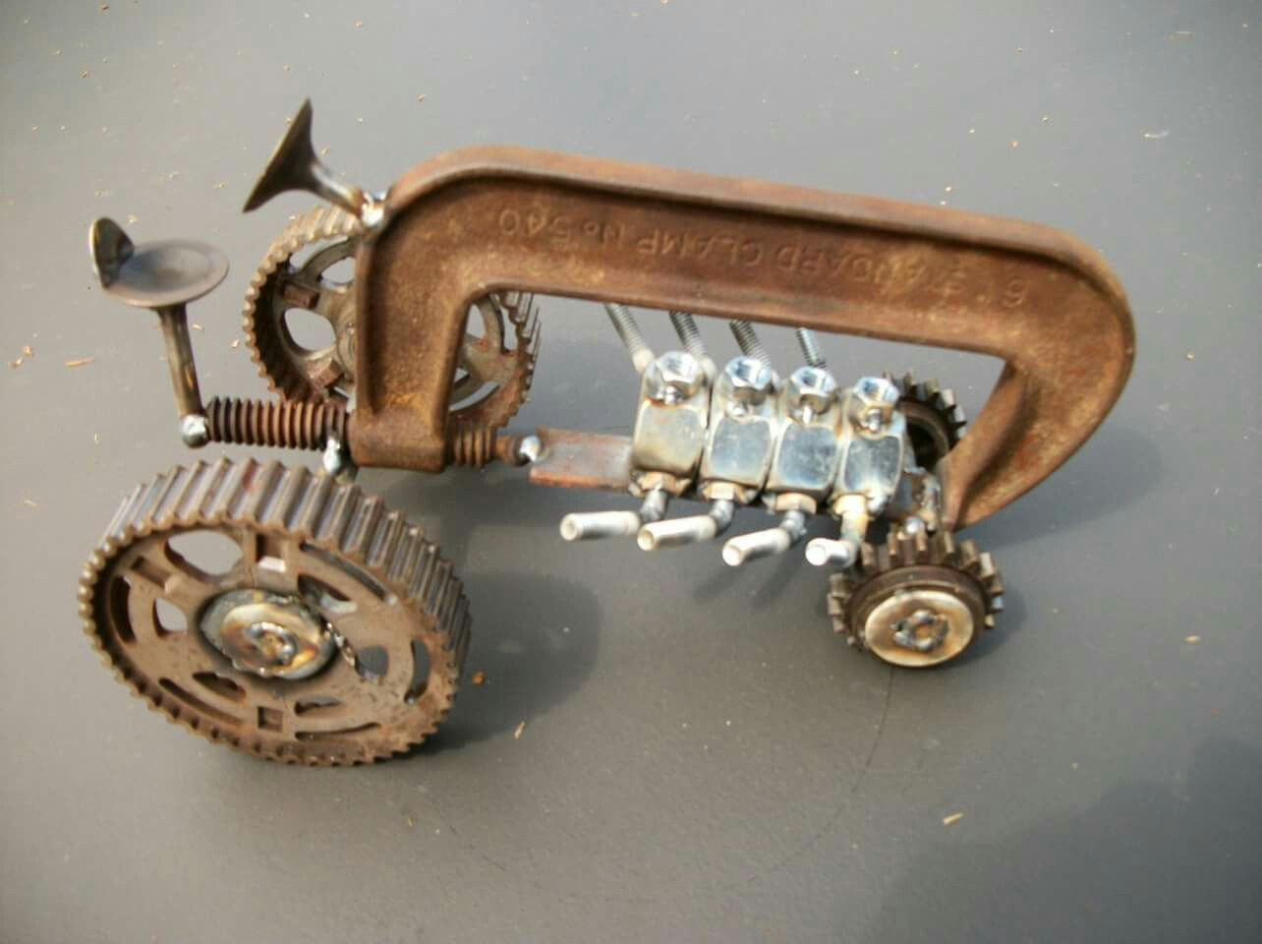
Basic Construction Project Tips
Metal Projects
Steel is the most commonly used metal in ag mechanics.
There are at least 4 kinds of steel.

Slide 61
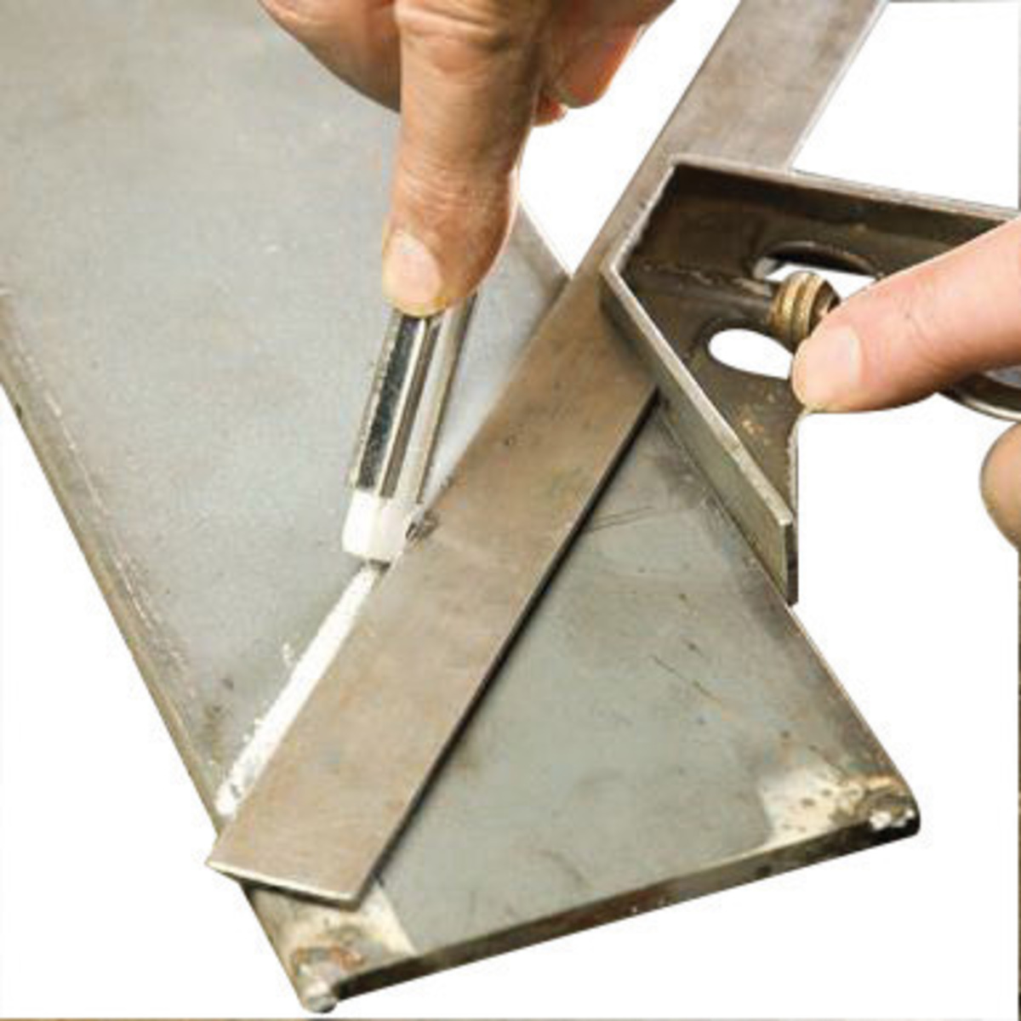
Basic Construction Project Tips
Metal Projects
Marking steel for cutting presents a special problem as pencil marks do not show up well.
Soapstone is a soft gray rock uses to mark most metals.

Slide 62
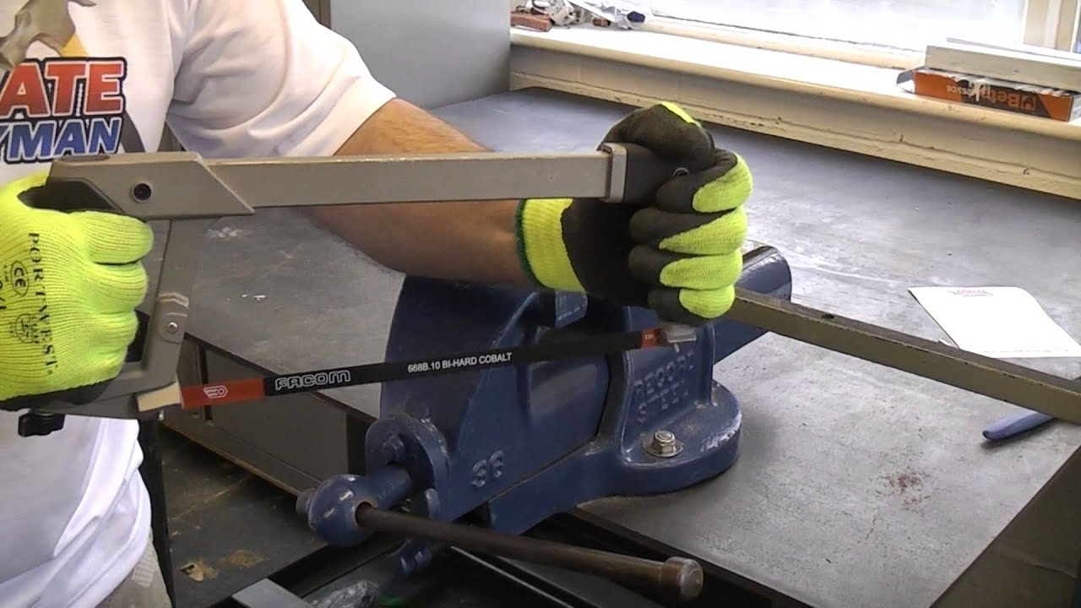
Basic Construction Project Tips
Metal Projects
The hacksaw is most often used for cutting metal, especially thin conduit.

Slide 63
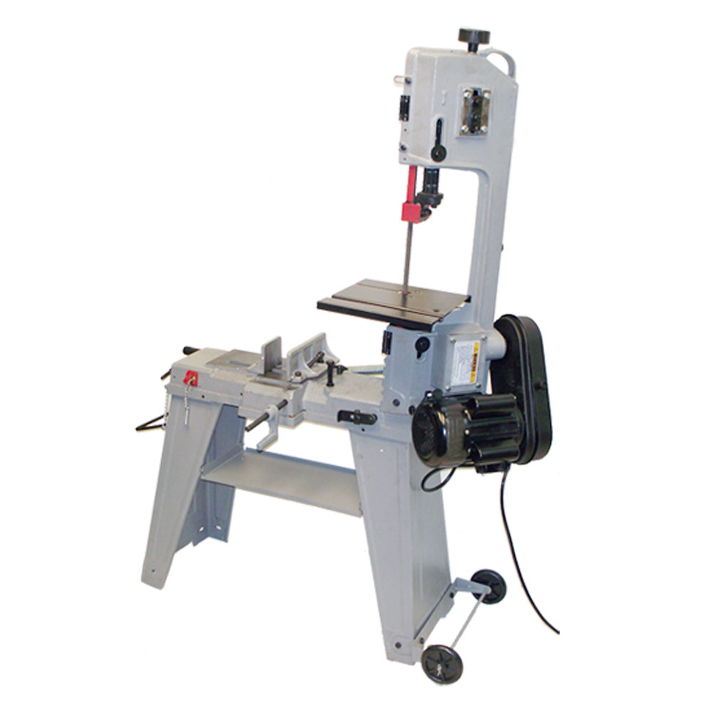
Basic Construction Project Tips
Metal Projects
Metal cutting band saws and power hacksaws may be used for large projects.

