Slide 1
Plant Identification
Tropicals

Slide 2
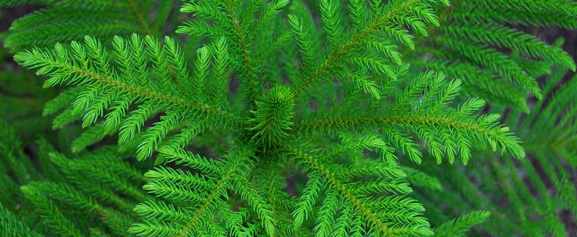
Norfolk Island Pine Araucaria heterophylla

Slide 3
Norfolk Island Pine Araucaria heterophylla
Description: Non-flowering, needled evergreen.
Water: medium
Fertilizer: weekly or biweekly applications of dilute liquid fertilizer from spring through fall
Light: Full sun is normally best for developing compact symmetrical growth, but some light afternoon shade may be needed to avoid possible foliage bleach (yellow tints).
Size and growth rate: 3-6 ft tall, slow growth
Propagation: cutting

Slide 4
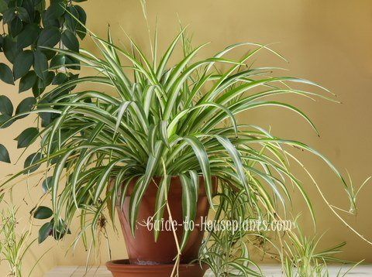
Spider plant Chlorophytum comosum cv.

Slide 5
Spider plant Chlorophytum comosum cv.
Description: Possibly the most popular of all houseplants, spider plant is a grass-like, clump forming, evergreen perennial in the lily family.
Water: water well when in full growth.
Fertilizer: Do not over fertilize as heavily fertilized plants may not form as many new plantlets. Your plants will not run short of nutrients; its tubers store reserve food
Light: bright indirect sunlight
Size and growth rate: 1-2 feet
Propagation: plantlets/cuttings

Slide 6
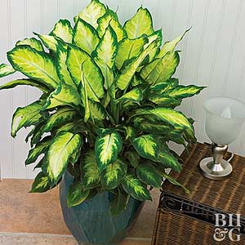
Dumb cane Dieffenbachia maculata

Slide 7
Dumb cane Dieffenbachia maculata
Description: This is a clustered perennial that features oblong pointed shiny leaves. Leaves are variable in color, generally being green with patches or blotches of cream/white.
Water: Water regularly during the growing season, but reduce watering from fall to late winter. Allow soils to dry between waterings.
Fertilizer: application of a complete water-soluble fertilizer, such as 20-20-20, every 4 to 6 weeks during the growing season will provide adequate nutrition
Light: bright, indirect light with protection from direct sun
Size and growth rate: In its native habitat, plants will grow to 6-10’ tall, however, they are generally kept much smaller when grown indoors in containers.
Propagation: stem or root cuttings

Slide 8
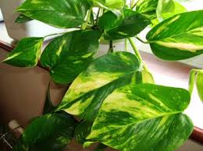
Golden Pothos Epipremnum aureum cv.

Slide 9
Golden Pothos Epipremnum aureum cv.
Description: a climbing vine that produces abundant yellow-marbled foliage. All parts of this plant are poisonous if ingested.
Water: Keep soil consistently moist during the growing season, but reduce watering somewhat from fall to late winter
Fertilizer: very little, as needed
Light: bright indirect light or in part sun locations with protection from afternoon sun
Size and growth rate: 6-8 feet
Propagation: stem cuttings

Slide 10
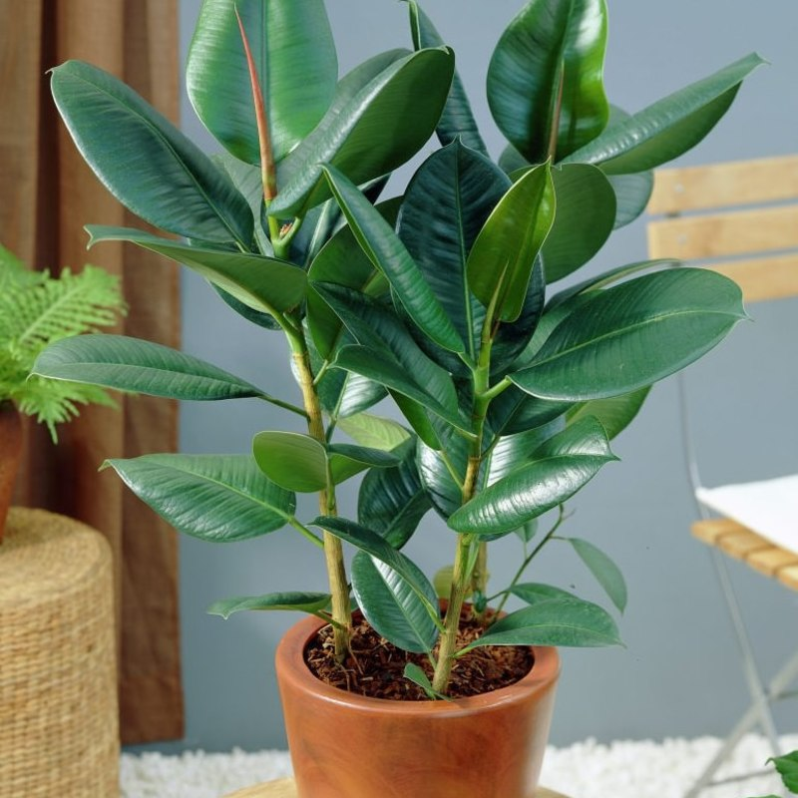
Decora Rubber Plant Ficus elastica "Decora" cv.

Slide 11
Decora Rubber Plant Ficus elastica "Decora" cv.
Description: It is noted for its thick, leathery, glossy, dark green leaves (to 12” long and 5” wide) and pink to purplish stipules.
Water: Water regularly during the growing season. Avoid overwatering. Reduce watering from fall to late winter.
Fertilizer: During the active growing months of spring and summer, fertilize with a liquid plant food once per month.
Light: bright indirect light or part shade with protection from afternoon sun.
Size and growth rate: 2-10 feet
Propagation: cuttings

Slide 12
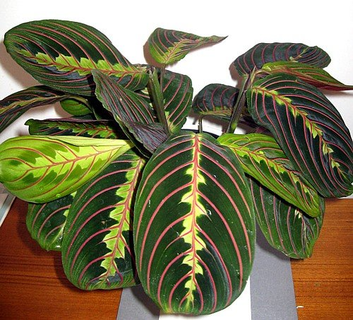
Prayer Plant Maranta leuconera

Slide 13
Prayer Plant Maranta leuconera
Description: an evergreen, rhizomatous, low-growing, clump-forming, tropical perennial that is noted for its beautiful foliage
Water: Keep soils consistently moist, but reduce soil moisture from autumn to late winter.
Fertilizer: fertilize monthly during the growing season
Light: bright indoor light but no strong direct sun. BEWARE: too much sun will bleach out the attractive leaf colors
Size and growth rate: 1-2 feet
Propagation: cutting or division

Slide 14
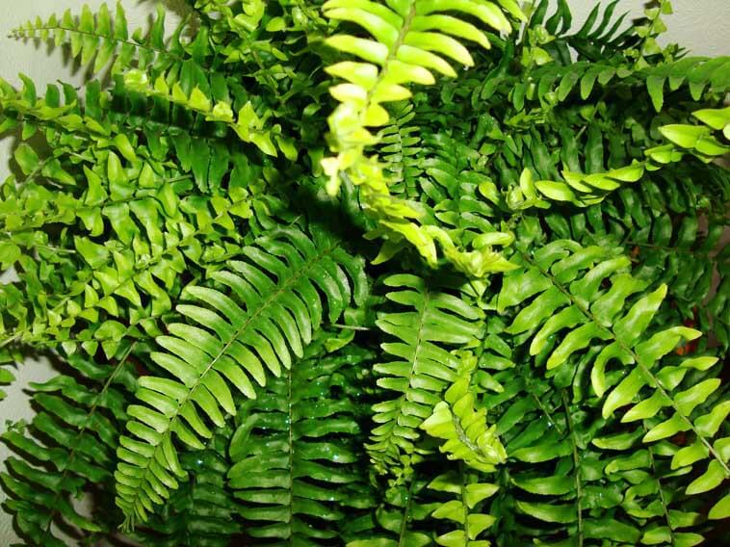
Boston Fern Nephrolepis exaltata cv.

Slide 15
Boston Fern Nephrolepis exaltata cv.
Description: It is an evergreen fern that grows with an upright spreading habit. Sword-shaped fronds have shallow toothed to entire pinnae. Fronds initially grow upward but arch gracefully with age.
Water: Soils should be kept consistently moist, with only a slight reduction in watering from fall to late winter. Prefers humid conditions.
Fertilizer: Weak fertilizer applications may be made monthly from spring to early fall
Light: bright indirect light with no direct sun
Size and growth rate: 3 feet
Propagation: Cuttings. Place plastic bag over cutting and place in indirect sunlight.

Slide 16
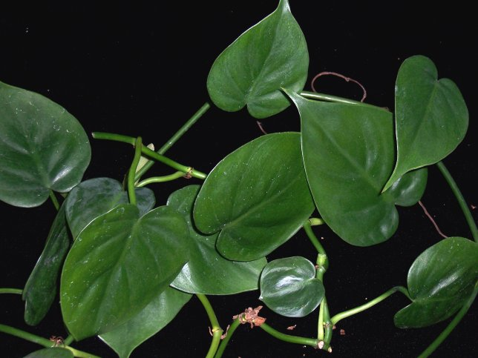
Parlor Ivy Philodendron scandens

Slide 17
Parlor Ivy Philodendron scandens
Description: Features bright, glossy, heart-shaped, dark green leaves that grow on a vine.
Water: Water regularly in the growing season, but reduce watering in fall to late winter
Fertilizer: as needed
Light: bright indirect light, avoid full sun. Tolerant of shade.
Size and growth rate: 4 feet
Propagation: Propagate by stem cuttings in spring. Pinch trailing stems to promote bushier growth.

Slide 18
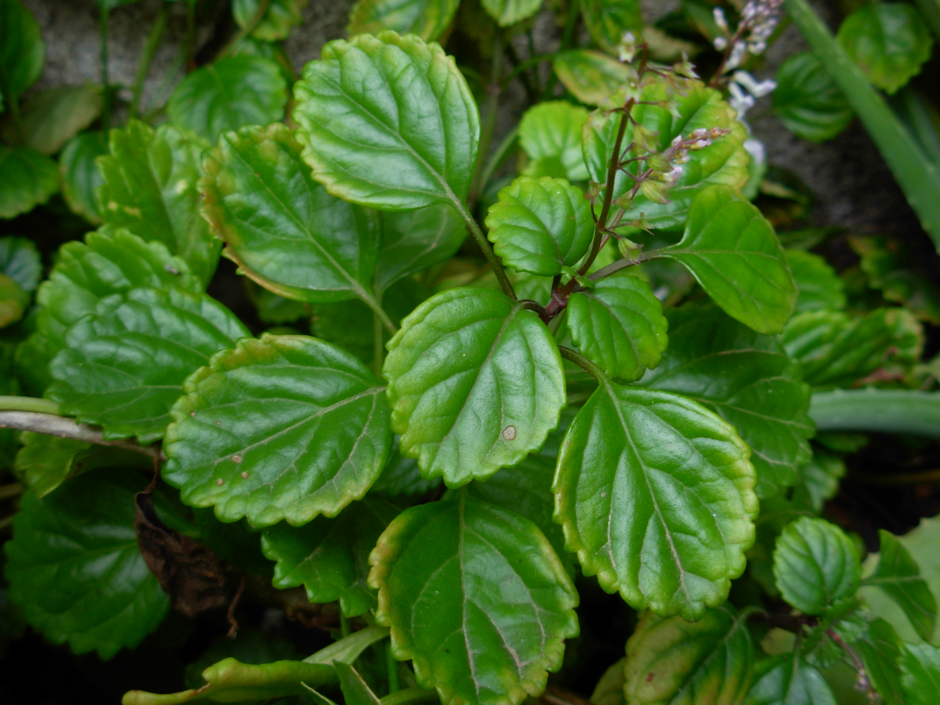
Swedish Ivy Plectranthus australis

Slide 19
Swedish Ivy Plectranthus australis
Description: Leaves on a growing Swedish ivy plant are glossy with scalloped edges. Tubular mauve to white flowers appear in spring throughout summer
Water: regular, even moisture
Fertilizer: as needed
Light: bright, mostly sunny exposures. Containers may be taken outside in summer but must be overwintered indoors.
Size and growth rate: 2-3 feet
Propagation: cuttings

Slide 20
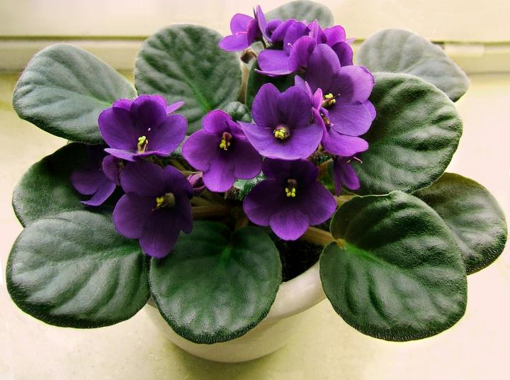
African violet Saintpaulia ionantha

Slide 21
African violet Saintpaulia ionantha
Description: It is a low, compact plant with attractive dark green, thick, hairy leaves. The violet-like flowers are borne in small panicles just above the foliage.
Water: The soil should be kept moist at all times, but it is desirable to keep the foliage dry.
Fertilizer: growers prefer one that has a higher phosphorus count (e.g. 15-30-15). It is believed to improve flowering.
Light: While they require good light, direct sunlight is not necessary. Windows facing north or east provide favorable light conditions
Size and growth rate: 0.5 - 0.75 feet
Propagation: leaf cuttings

Slide 22
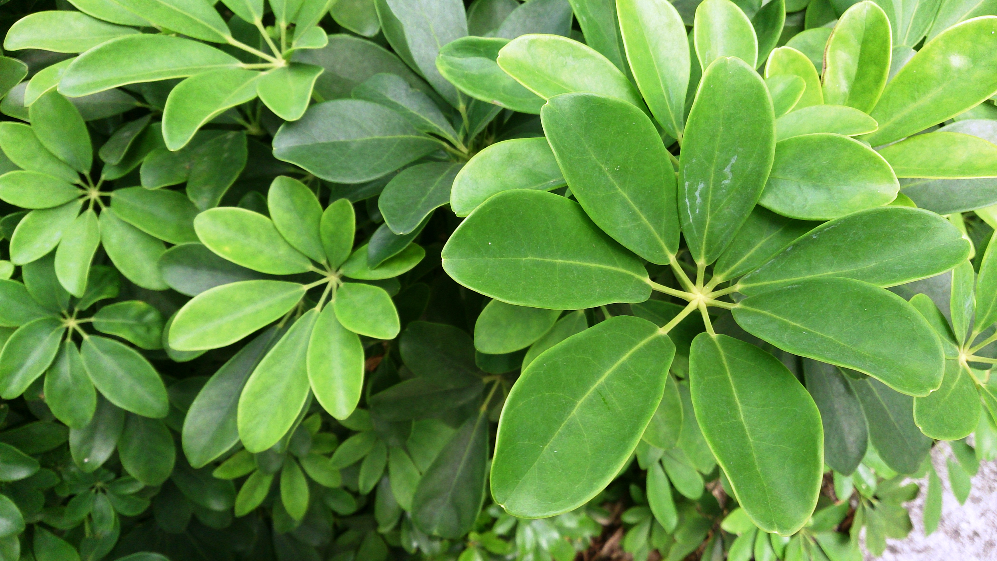
Dwarf Schefflera Schefflera arboricola

Slide 23
Dwarf Schefflera Schefflera arboricola
Description: an evergreen shrub or small tree with glossy, slender-stalked, compound, palmate, evergreen leaves
Water: Avoid overwatering. Best to deeply water and then allow soils to nearly dry before applying an additional deep watering.
Fertilizer: unnecessary
Light: bright light at east, west or southern windows in curtain filtered sun
Size and growth rate: 3-6 feet
Propagation: stem cutting

Slide 24
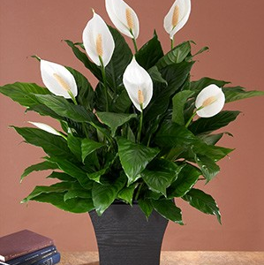
Peace Lily Spathiphyllum cvs.

Slide 25
Peace Lily Spathiphyllum cvs.
Description: Spathiphyllum is Greek for leaf-spathe, referring to the character of the spathe, which is the bract or leaf surrounding or subtending a thick, protruding flower cluster. This easy care plant has beautiful glossy green leaves and the unusual ability to blossom in medium light.
Water: Let the soil dry between waterings, but do not allow to wilt; this causes the leaves to yellow.
Fertilizer: every 6 weeks with 20-20-20
Light: part shade to full shade
Size and growth rate: 1-6 feet
Propagation: division of rhizome

Slide 26
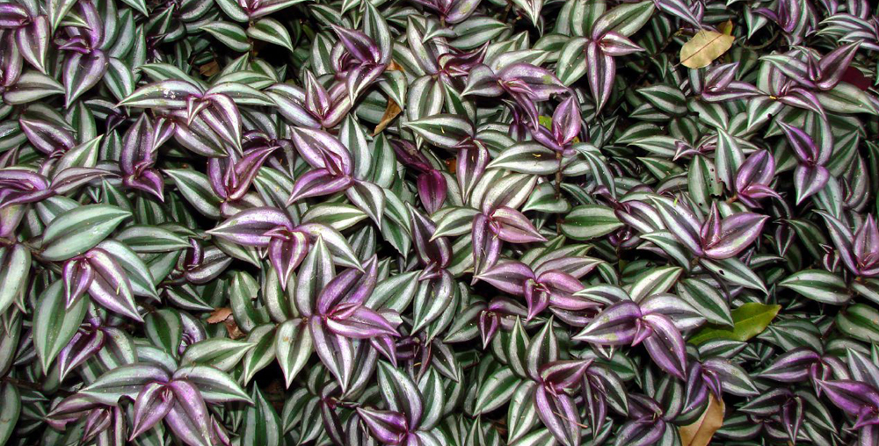
Purple Wandering Jew Tradescantia zebrina

Slide 27
Purple Wandering Jew Tradescantia zebrina
Description: This trailing perennial is grown for its foliage; lovely leaves of gray green have silver stripes and dark purple reverses; low maintenance, and excellent for containers or massed as groundcover
Water: consistently moist but well-drained soil during the growing season, with reduced watering from fall to late winter.
Fertilizer: feed plant monthly
Light: Best in filtered sun. Will grow in direct sun with some afternoon protection. Also grows in shade.
Size and growth rate: 14 inches
Propagation: Cuttings

